Slide 1
Unit II and III
ESSAY TOPIC REVIEW

Slide 2
Topic I: How has Britain adjusted in a post colonial World:
Multiculturalism Devolution
Fragmentation Constitutional Changes
Diversity
Ethnic Minorities
7/7/05
9/11/01
“Longest Reign over them” Unit II Packet
“No one knows what Britain is anymore” NY Times Article
Brexit

Slide 3
Topic II: Europe and the Democratic Deficit
Chocolate Directive
McLibel Case
Wine and French Vintners
British Beef Ban
Kesselman Text: Pages 140-149 and 164-166
ECJ?
Describe how this has lead many observers to suggest Europe has a democratic deficit problem and how citizen’s feel increasingly frustrated with Europe and its institutions.

Slide 4
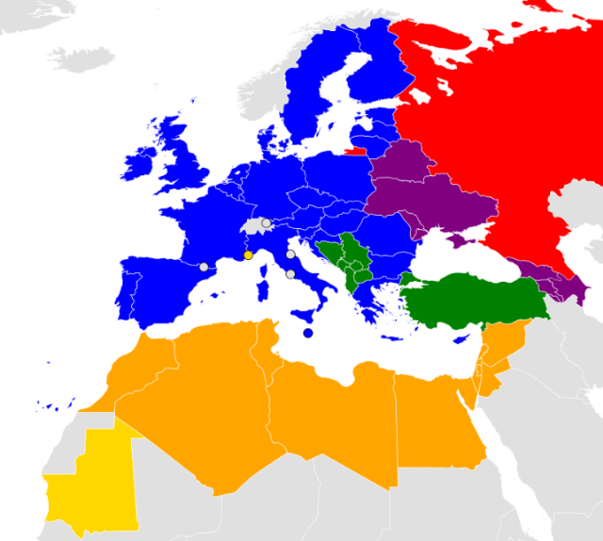
Let them in ? Keep them out?
A case study on EU enlargement.
BBC article
Discuss the Pros and Cons of admitting a country to the EU, even with Brexit happening. Three pros and three cons.

